Slide 1
.
بسم الله الرحمن الرحیم

Slide 2
Treatment of Hypertension
Based on the latest recommendations of
JNC 8, ISH, ESH, WHO
Kamran Mohammadi MD

Slide 3
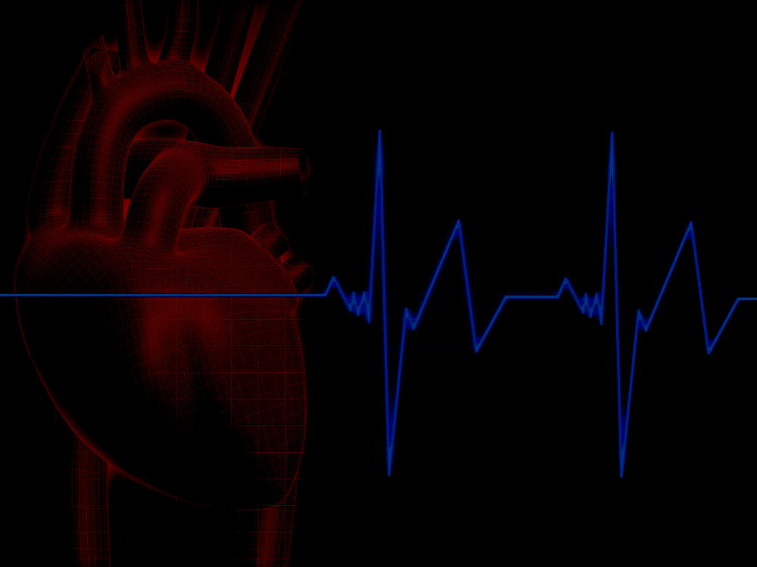
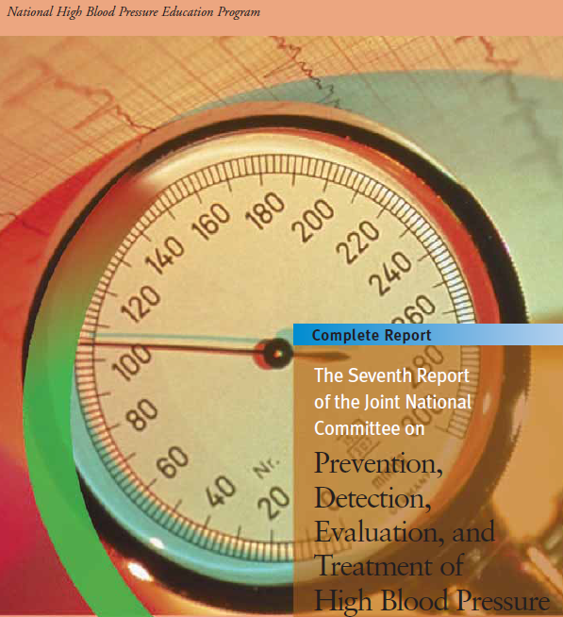
Joint National Committee (JNC)
Panel appointed by the National Heart, Lung, and Blood Institute (NHLBI)
First guidelines (JNC-1) published in 1977
Subsequent updates published in 3- to 6-year intervals
Last edition (JNC-7) published in 2003

Slide 4
DIAGNOSIS OF HYPERTENSION
An initially elevated office blood pressure (BP)—higher than 140 mm Hg systolic or 90 mm Hg diastolic—must always be confrmed either by home or ambulatory BP monitoring,
or
must be remeasured at least three times over a period of at least 4 weeks
Only if the office BP level is very high (≥180/110 mm Hg) or if symptomatic target-organ damage is present should therapy begin before the diagnosis is carefully established.

Slide 5
Routine investigations
CBC
U/A for protein and blood
Cr , Na , K
FBS
Blood lipid profile
EKG

Slide 6
Lifestyle changes for hypertensive patients
Recommendations to reduce BP and/or CV risk factors
Salt intake | Restrict 5-6 g/day
Moderate alcohol intake | Limit to 20-30 g/day men, 10-20 g/day women
Increase vegetable, fruit, low-fat dairy intake
BMI goal | 25 kg/m²
Waist circumference goal | Men: <102 cm (40 in.)* Women: <88 cm (34 in.)*
Exercise goals | ≥30 min/day, 5-7 days/week (moderate, dynamic exercise)
Quit smoking

Slide 7
Lifestyle Modification
Modification | Approximate BP reduction (range)
Weight reduction | 5–20 mm/10 kg wt loss
Adopt DASH eating plan | 8–14 mmHg
Dietary sodium reduction | 2–8 mmHg
Physical activity | 4–9 mmHg
Abstinence from alcohol | 2–4 mmHg

Slide 8


Slide 9
.
Rule of Halves in HT :
For every 800 adults in the community
400 are HT (either ↑ SBP or ↑ DBP or both)
Of them only 200 are diagnosed HT
Of them only 100 are started on treatment
Of them only 50 are on correct drug
Of them in only 25 the goal B.P. is attained
Means 25 ÷ 400 = 6% only have goal BP

Slide 10
HTN Classification
Category | SBP (mm Hg) | DBP (mm Hg)
Normal | < 120 | < 80
Pre – hypertension | 120-139 | 80-90
Hypertension
Stage 1 | 140 – 159 | 90 – 99
Stage 2 | 160 and above | 100 and above

Slide 11
Development of JNC-8
3 critical questions for adults with hypertension:
  When to start therapy?
  How low should I go?
  What drug do I use?

Slide 12
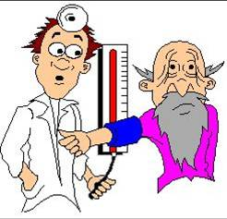
BP goal in the elderly

Slide 13
JNC-8 Recommendations
In patients >60 years of age, start medications at blood pressure of >150/90mm Hg and treat to goal of <150/90mm Hg

Slide 14
JNC-8 Recommendations
In patients <60 years of age, start medications at blood pressure of >140/90mm Hg and treat to goal of <140/90mm Hg
In all adult patients with diabetes or chronic kidney disease, start medications at blood pressure of >140/90mm Hg and treat to goal of <140/90mm Hg

Slide 15
Lower limit:
.
Keep B.P. < 140/90 mm Hg in each patient
This may be revised to 120/80 may be ? 110/70
MRFIT’s cut off values are 115/75 mm Hg
.

Slide 16
.
In most of the patients of hypertension
Two drugs are required for adequate control.

Slide 17
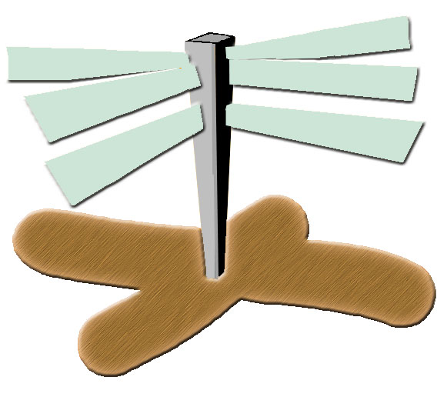
The Many Faces of HT Therapy Today
CCBs
Centrally acting agents
ARBs
Diuretics
ACE – inhibitors
Beta blockers
Hypertension
Notes:
When it comes to hypertension, there are basically 6 classes of anti-hypertensives, with each appearing as a probable option.
And the interesting part is that pharmaceutical companies push their product option forward as the ideal approach.
This means that more often than not, we physicians are bombarded with confusing rather than convincing data, as to the right approach.
Treatment of mild hypertension study (TOMHS) has conclusively proven that there is little if any distinction among the different anti-hypertensive agents for reducing blood pressure. The next question is then which antihypertensive? Naturally, one that has more favourable effects on cardiovascular endpoints and mortality.
With studies like the HOPE trial proving that ACE inhibitors demonstrate dramatic cardioprotective effects apart from BP reduction, Ace inhibitors are getting better acceptance.
But, ACE inhibitors could range from the old reliable tried and trusted ones like enalapril or the better researched and studied ones like ramipril or fosinopril?

Slide 18
First-Line Drug Classes
(1) Calcium channel blockers (CCBs).
(2) Renin-angiotensin system (RAS) inhibitors, either angiotensin-converting enzyme inhibitors (ACEIs) or angiotensin receptor blockers (ARBs).
(3) Thiazide-type diuretics.

Slide 19
beta-adrenergic blockers
beta-adrenergic blockers are frst-line drugs for h/o ACS and heart failure or palpitation.
Atenolol vs non atenolol BB.

Slide 20
The A B/ C D approach:
A
ACEI, ARB
C
Ca-Blockers
B
β-Blockers
D
Diuretics

Slide 21
AB/CD Rule – HT Treatment
AGE
Younger p.
High Renin
Renin
Older p.
Low Renin HT
ACE
BB
CCB
Diuretic

Slide 22
Which drug in each class:
ARB
ACEi
BB
CCB
DIU
HCTZ
Chlortha
Furosemi
Spirono
Enalapril
Lisinopril
Losartan
Valsartan
Captopril
Triamter
Metoprol
Carvedio
Atenelol
Proprano
Labetolol
Amlodep
Verapam
Diltiazem

Slide 23
JNC 8: Subsequent Management
Reassess treatment monthly
Avoid ACEI/ARB combination
Consider 2-drug initial therapy for Stage 2 HTN (> 160/100)
The best combination is A+C
Goal BP not reached with 3 drugs, use drugs from other classes
  Consider referral to HTN specialist

Slide 24
Comparison of Recent
Guideline Statements
 | JNC 8 | ESH/ESC | AHA/ACC | ASH/ISH
 |  | >140/90
Threshold | >140/90 < 60 yr | Eldery SBP >160 |  | >140/90 <80 yr
for Drug Rx | >150/90 >60 yr | Consider SBP | >140/90 | >150/90 >80 yr
 |  | 140-150 if <80 yr
B-blocker | No | Yes | No | No
First line Rx
Initiate Therapy | >160/100 | "Markedly | >160/100 | >160/100
w/ 2 drugs |  | elevated BP"

Slide 25
CCBs: Advantages of amlodipine include :
Once-daily dosing because of its long half life.
Tolerability.
Cost.
Unlike diuretics and RAS inhibitors, a high-salt diet or concurrent NSAID therapy does not compromise the effectiveness of amlodipine.

Slide 26
Verapamil and Diltiazem:
Verapamil is weakly antihypertensive and has limited usefulness because of dose-dependent constipation.
Diltiazem is intermediate in potency between verapamil and the dihydropyridines and is usually well tolerated.

Slide 27
Side Effects
The principal side effect of the amlodipine is dose-dependent ankle edema.
With amlodipine, ankle edema is far more common with a 10-mg dose than with 2.5- or 5-mg doses. This edema appears to be vasogenic because of selective arterial dilation and can respond to concomitant therapy with an ACEI or ARB that causes balanced arterial and venous dilation.

Slide 28
ACEIs/ARBs:
As monotherapy, ACEIs are generally less effective in lowering BP in black patients and in older patients.
with low-renin hypertension, but they are quite effective in these groups when combined with a low-dose diuretic or CCB.

Slide 29
Side Effects
All RAS inhibitors are contraindicated in pregnancy.
The most common side effect of ACEIs is a
dry cough.
Hyperkalemia.
In patients with stage 3 CKD with proteinuria, initiation of ACEI or ARB therapy is often associated with a small transient increase in serum creatinine; therapy can be continued unless the elevation in creatinine is greater than 30%, an indication to decrease the dose or temporarily withhold therapy.

Slide 30
Chlorthalidone rather than HCTZ:
Even though HCTZ has enjoyed widespread use in clinical practice, chlorthalidone is the choice for practicing evidence-based medicine.
chlorthalidone, a thiazide-like diuretic that is more potent and longer lasting than HCTZ .

Slide 31
.
Loop diuretics are less effective BP-lowering agents and should be reserved for treating hypertension in the setting of advanced CKD (stage 3 or higher).
Chlorthalidone may also be effective in patients with stage 3 CKD.
Diuretics enhance the potency of all other classes of antihypertensive agents.

Slide 32
:Side Effects
Glucose intolerance (particularly in higher doses and when used in combination with a beta blocker),
Hypokalemia , hypomagnesemia, and severe hyponatremia especially in older adults
precipitate gout, and elevate serum lipids.
erectile dysfunction.
These drugs have higher discontinuation rates.

Slide 33
:BB Side Effects
Standard beta blockers increase the risk for diabetes, particularly when combined with a diuretic.
Common side effects such as fatigability cause high discontinuation rates.
precipitate acute bronchospasm.
All beta-blocking drugs promote weight gain.

Slide 34
Clinical Use of alfa blockers:
They are effective add-on therapy for diffcult hypertension and
are useful in older men with prostatism.
Major Side effect: orthostatic hypotension

Slide 35
:Resistant Hypertension
Resistant hypertension—defined as:
high BP uncontrolled with three or
controlled with at least four antihypertensive drugs (including a diuretic)—is associated with a higher prevalence of secondary hypertension and worse CV and renal outcomes.
With aging of the population, the prevalence of resistant hypertension is increasing and is estimated to affect 13% to 20% of the adult U.S. population.

Slide 36
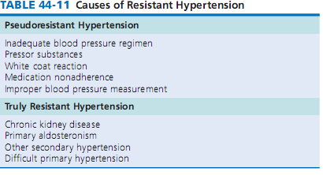
.

Slide 37
Spironolactone and carvedilol:
In the absence of an identifable cause of the hypertension, spironolactone or a vasodilating beta blocker (carvedilol) can serve as highly effective add-on therapies.

Slide 38
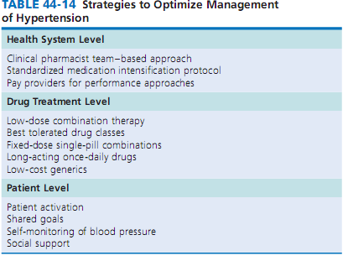
.

Slide 39
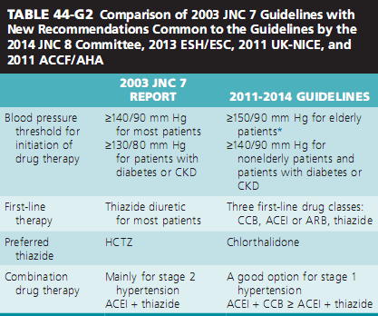
.

Slide 40
Defnition of HYPERTENSIVE CRISES:
Hypertensive crises are a heterogeneous group of hypertensive disorders characterized by :
severe hypertension and acute target-organ damage to the brain, heart, kidney, retina, or blood vessels.
Typically, BP is 220/130 mm Hg or higher but may be much lower in women with preeclampsia who do not have preexisting hypertension such that cerebral autoregulation has not been reset.
Hypertensive crises require immediate reduction of BP with intravenous medication and intra-arterial monitoring in an intensive care unit.

Slide 41
hypertensive urgency:
In contrast, hypertensive urgency denotes severe uncontrolled hypertension without evidence of acute target-organ damage.
In the absence of symptoms and acute target-organ damage, a patient with a BP of 220/130 mm Hg should be treated with a short-acting oral medication.

Slide 42
Severe hypertension:
Severe hypertension, defned as a BP of 180/110 mm Hg to 220/130 mm Hg without symptoms or acute target-organ damage, almost always occurs in patients with chronic hypertension who ran out of or stopped taking their BP medication.
Long-acting oral medication can simply be restarted.
Patients with either hypertensive urgency or severe hypertension require outpatient follow up within 24 to 72 hours by either a primary care physician or hypertension specialist.

Slide 43
Management of Specifc :Hypertensive Crises
In patients with impaired cerebral autoregulation ,labetalol causes a smaller adverse fall in cerebral blood flow than nitroprusside does but has a longer half-life, which leads to more adverse episodes of systemic hypotension.
Intravenous nicardipine appears to produce a more predictable and consistent reduction in BP than labetalol does, but with a similar safety profle; however, physicians and hospital pharmacies are less familiar with nicardipine.

Slide 44
Summary:
Resistant Hypertension: not achived to goal
Severe hypertension: > 180/110
hypertensive urgency: >220/130
HYPERTENSIVE CRISES: >220/130 with TOD

Slide 45
Hypertensive Crisis with Encephalopathy:
Hypertensive encephalopathy is characterized by a reduced level of consciousness, delirium, agitation, stupor, seizures, or cortical blindness in the setting of acute severe high BP.
Focal neurologic signs are rare and suggest ischemic or hemorrhagic stroke rather than encephalopathy.
Hypertensive encephalopathy is a cause of reversible posterior leukoencephalopathy syndrome, which is often seen in the setting of cyclosporine- or tacrolimus-induced hypertension (particularly in heart transplant recipients) or that caused by bevacizumab or bortezomib.

Slide 46
Brain computed tomography or magnetic resonance imaging showing areas of cerebral edema confrms the diagnosis of encephalopathy.
The edema typically localizes in posterior brain regions perfused by the vertebral arteries, which have less sympathetic innervation and thus less dampening of BP oscillations than the carotid arteries do.
The areas of brain edema will resolve with timely treatment of the hypertensive crisis.

Slide 47
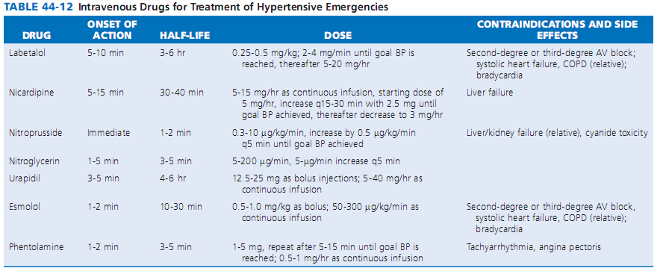

Slide 48
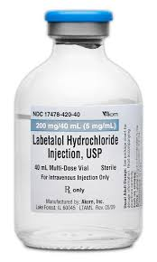
.

Slide 49
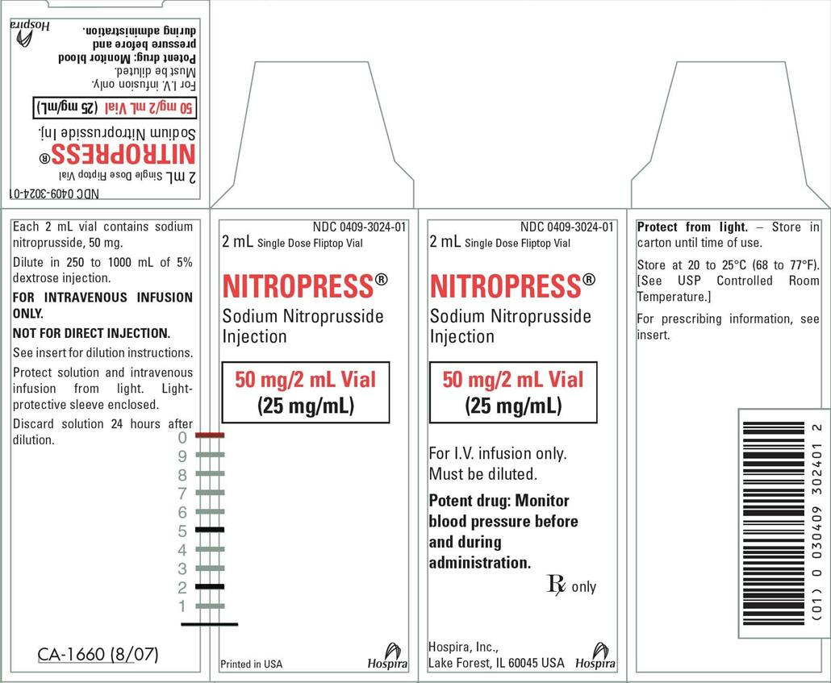

Slide 50
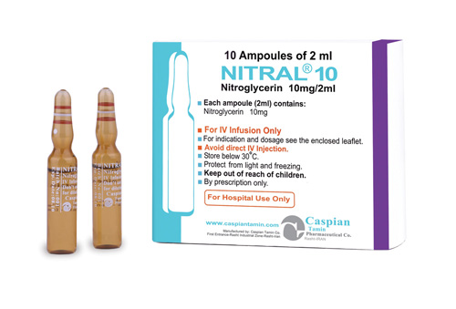
.

Slide 51
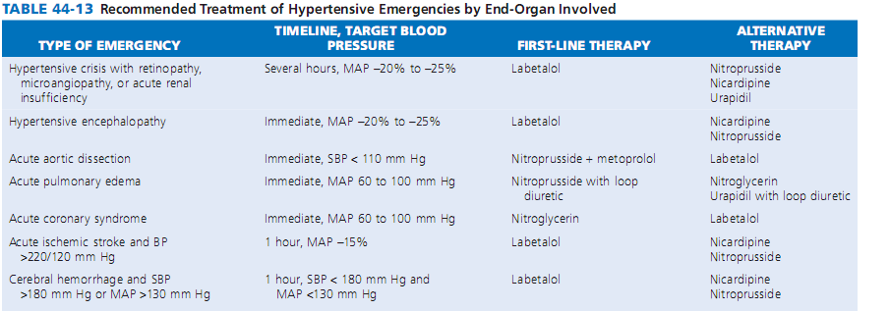

Slide 52
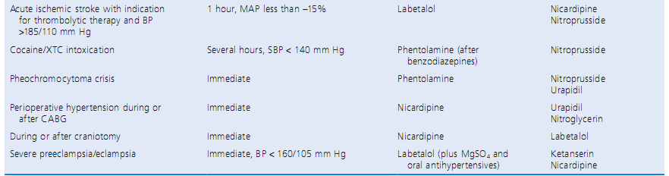

Slide 53
Cerebral autoregulation:
Encephalopathy occurs when BP exceeds the upper limit of cerebral autoregulation, which normally maintains cerebral blood fow constant over a range of mean arterial pressure from 60 to 150 mm Hg.
In patients without preexisting hypertension, such as those with preeclampsia, encephalopathy will develop when mean arterial pressure exceeds 150 mm Hg.
In those with chronic hypertension, the autoregulatory curve shifts to the right to defend against a higher level of BP, but this adjustment makes patients vulnerable to cerebral underperfusion if BP is lowered too quickly into the normotensive range.

Slide 54
BP goal in hypertensive encephalopathy :
Thus patients with hypertensive encephalopathy should receive intravenous antihypertensive therapy—preferably with labetalol—immediately to lower BP in a controlled manner that avoids cerebral hypoperfusion and thus irreversible brain damage.
A good rule of thumb is to lower the initially elevated arterial pressure by 10% in the frst hour and by an additional 15% during the next 12 hours to a BP of no less than 160/110 mm Hg.
BP can be reduced further during the next 48 hours.

Slide 55
Acute Ischemic or Hemorrhagic Stroke
(1) if the stroke cannot be treated with thrombolytic therapy, BP should be treated if it remains higher than 220/120 mm Hg and initially lowered by no more than 15%, and
(2) if the stroke can be treated with thrombolytic therapy, BP needs to be lowered to less than 185/110 mm Hg

Slide 56
hemorrhagic stroke:
Recent results of INTERACT2 (Intensive BP Reduction in Acute Hemorrhage Trial 2) showed improved functional outcomes without more adverse events in patients with acute hemorrhagic stroke randomly assigned to intensive treatment to lower SBP to less than 140 mm Hg than to the conservative guideline-recommended goal of less than 180 mm Hg.
For either ischemic or hemorrhagic stroke, agents of choice to lower BP include urapidil, nicardipine, or labetalol; nitroprusside and hydralazine should be avoided.

Slide 57
Hypertension
Case specific approach
some selected case scenarios

Slide 58
Case specific approach
Case 1 | Stage 1 HT | Single Drug | Combination T
Case 2 | Stage 2 HT | Two Drugs | A+ C
Case 3 | HT + Tachycardia | Beta blockers | -

Slide 59
Case specific approach
Case 4 | HT + MI | BB
Case 5 | HT + DM | ARB, ACEi
Case 6 | HT + BPH | α bloc, Tamsu
Case 7 | HT + Dys lipidem. | ACEi, CCB

Slide 60

Learning is a cyclical process
Thank You all
Any question or coment?

